Slide 1
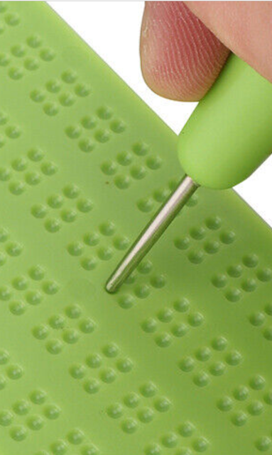
Lamb industries Supporting unit focused task: braille products
#InspiredbyLambIndustries
Notes:
Please note; This resource, accompanying resources and associated images, videos and graphics are to be used for educational purposes only and in line with our terms and conditions as stated here. https://www.designtechnology.org.uk/terms-and-conditions-and-policies/

Slide 2
Braille products
Because design and innovation matter

Slide 3
braille
There are a range of products on the market designed specifically for people with visual impairments, but you can also adapt products to be more accessible for people who have difficulty with their sight. One way of adapting an existing product is to introduce Braille labels.
In this unit we will look at a few different ways this can be achieved with the tools and machines available in the D&T department.
Notes:
For further details on braille and issues related to limited sight, visit https://www.pocklington.org.uk/

Slide 4
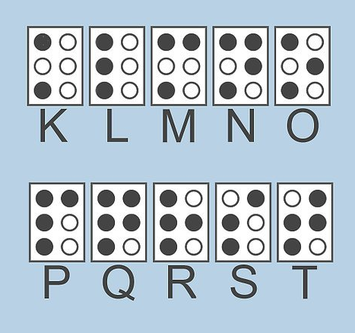
braille products
Braille is a system of reading and writing in your language without the use of sight and enables people with blindness and visual impairments to read and write.
Grade 1 braille consists of the 26 standard letters of the alphabet and punctuation. It’s mainly used by people who just started reading Braille.
Braille employs ‘contractions’ that substitute shorter sequences for the full spelling of commonly-occurring letter groups. This is referred to as ‘Grade 2’ in contrast to ‘Grade 1’ transcriptions where all words are spelled out letter-for-letter.

Slide 5
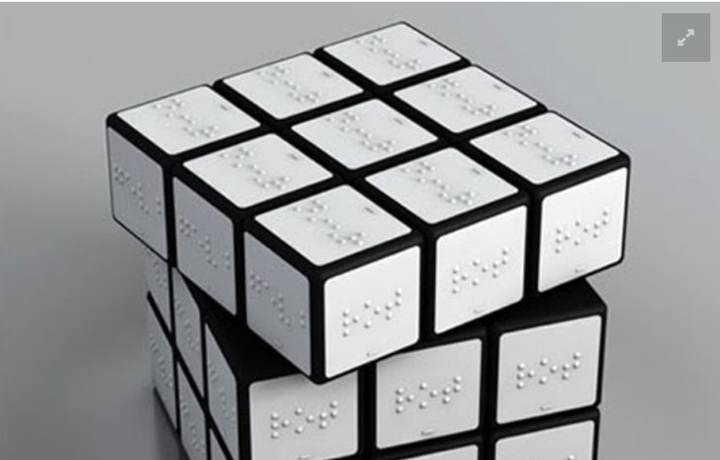
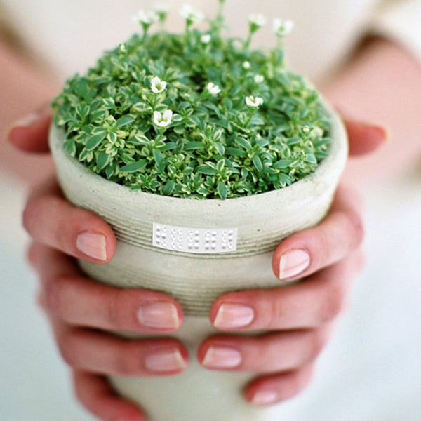
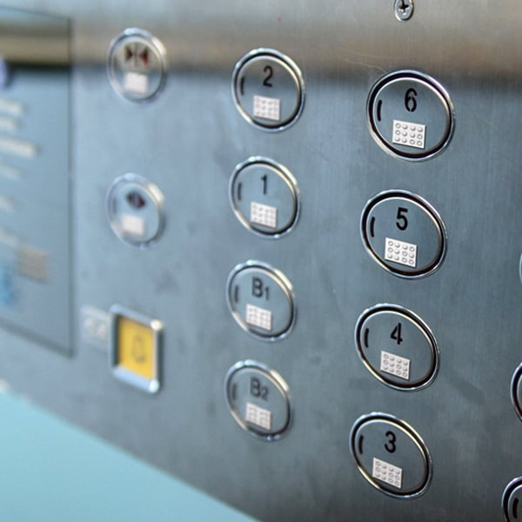
BRAILLE PRODUCTS
Many consumer products already have braille writing on them, but some need to be adapted to make them more accessible to the visually impaired. These are just a few examples of existing products that have been adapted to make them more inclusive.
Notes:
You may want to bring in some examples of products with braille on them. These are often found on bottle of bleach and other toiletry items and discuss why they feature on these. Also why they are not on every item produced.

Slide 6
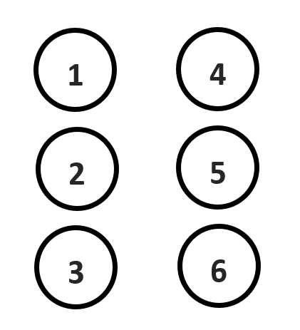
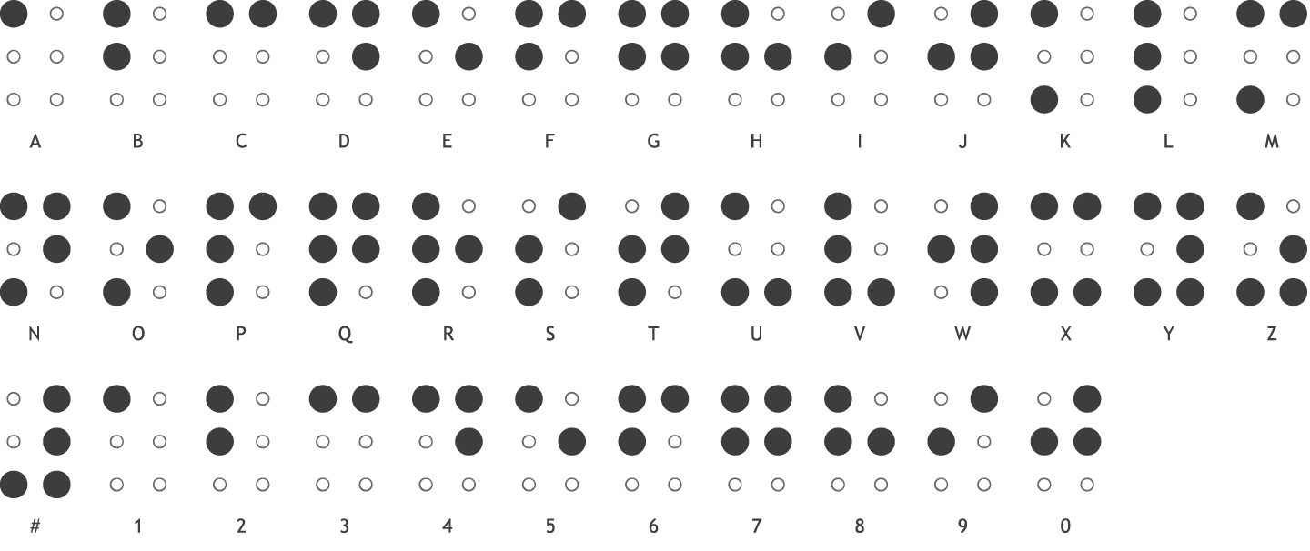
Writing braille
Using the alphabet and a simple template, students can practice braille by shading in the relevant circles 1-6 to spell out the labels. These could be used for labelling plants, tools or storage

Slide 7
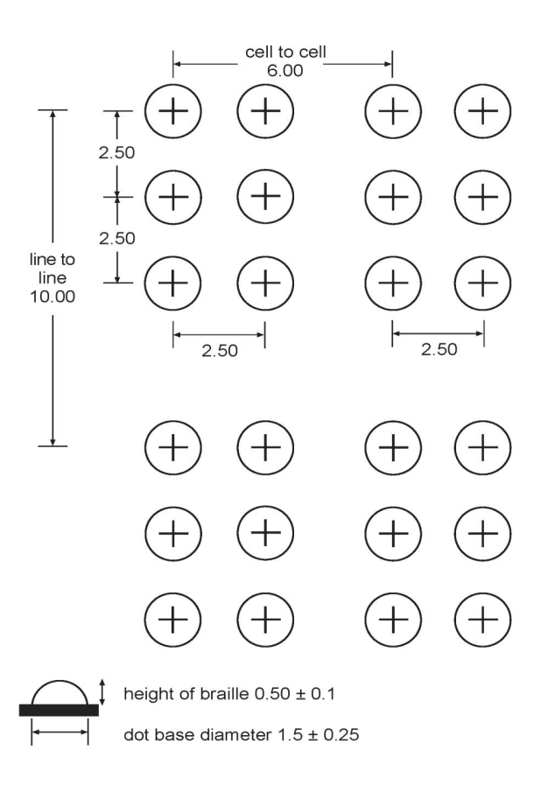
Making braille labels
It’s important to have a standard for the size and spacing of braille to make it easy to follow. These dimensions are the UK standard and can be used to design braille labels to use with gardening products.
There are several ways we can do this from punching dots into paper, using simple blobs of glue or 3D printing labels that will be much more durable, especially if used outside or in wet conditions.
Information from www.ukaaf.org

Slide 8
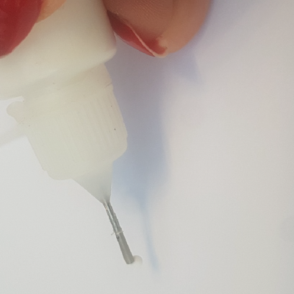
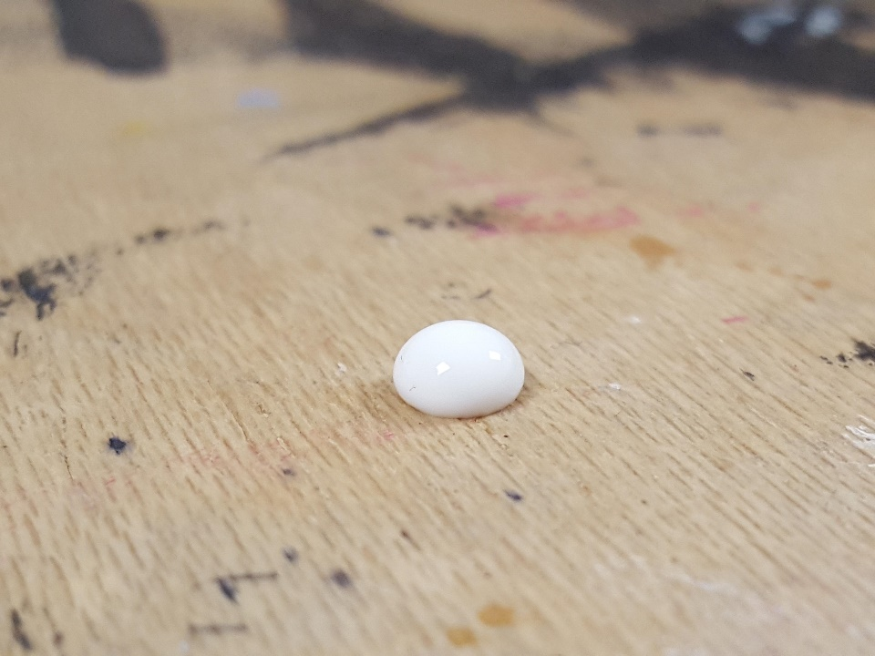
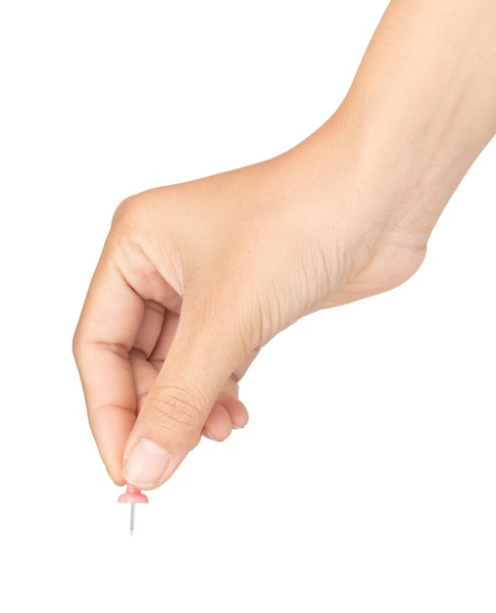
Glue blobs
Using a needle or a bottle with a small nozzle, you could drop a single blob of glue to make a braille dot. Do this on transparent film such as acetate sheet and you can put a braille letter template underneath to ‘trace over’.

Slide 9
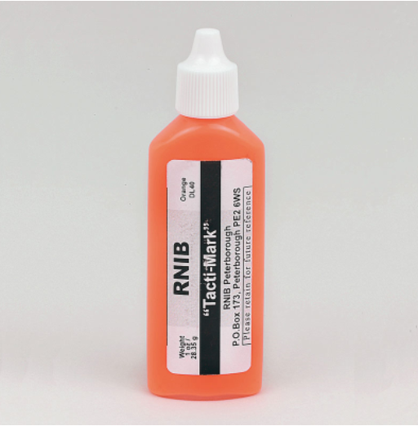
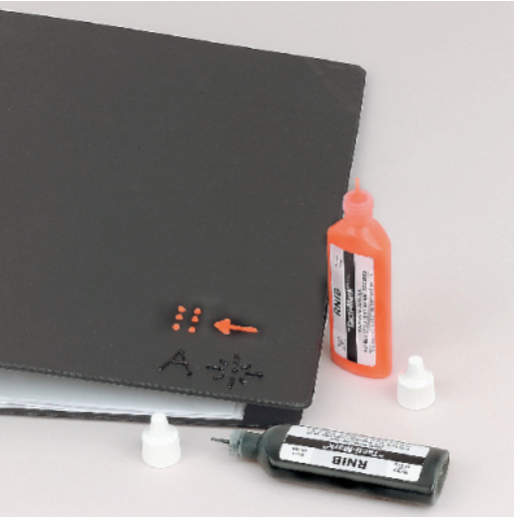
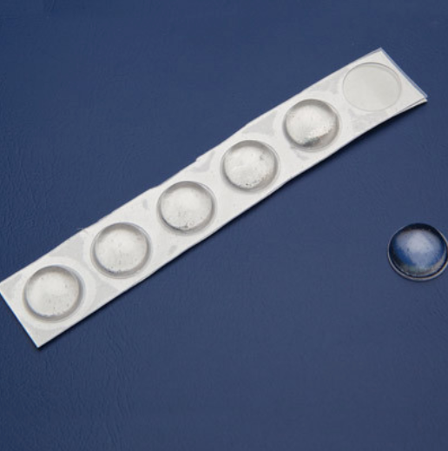
Tacti-mark
The RNIB sell a special fluid that can be used in the same way as blobs of glue to make raised marks on existing products. They also sell self adhesive dots.
Notes:
Consider purchasing some of these for use in the class https://shop.rnib.org.uk/

Slide 10
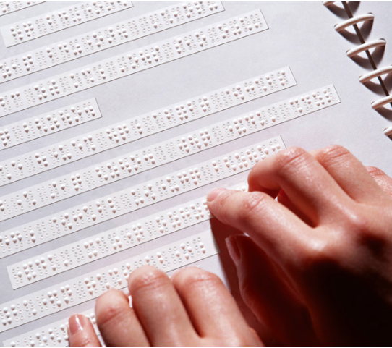
Punching paper
There are a range of tools available to buy that can be used to mark Braille onto paper or card by pushing a tool into a recess on a board.
Students may wish to design their own system for making paper-based labels.
Notes:
Examples are on Amazon for around £8

Slide 11
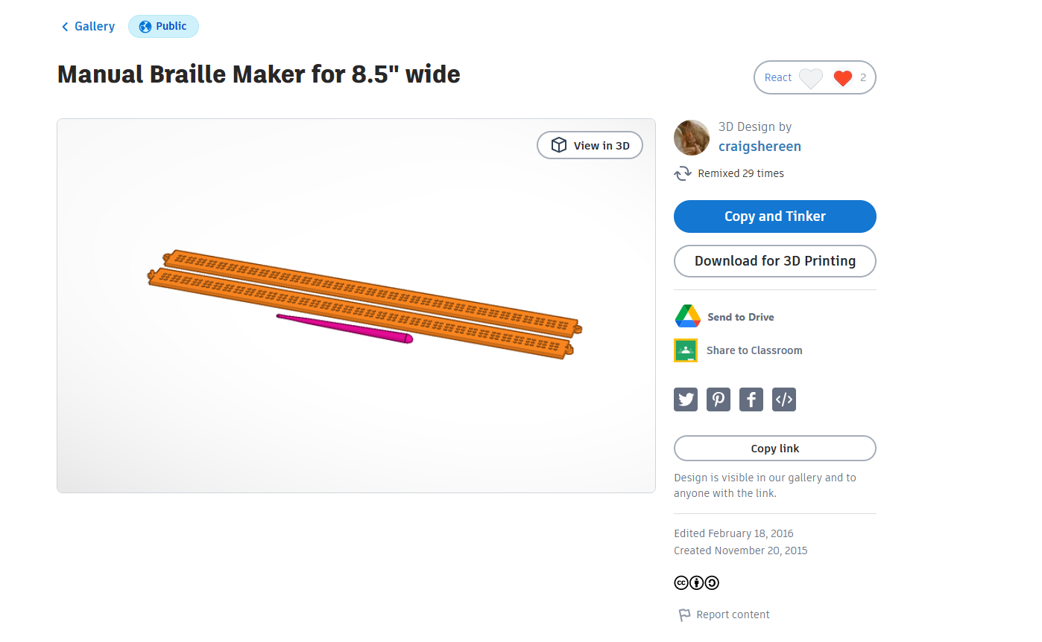
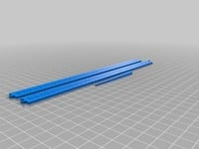
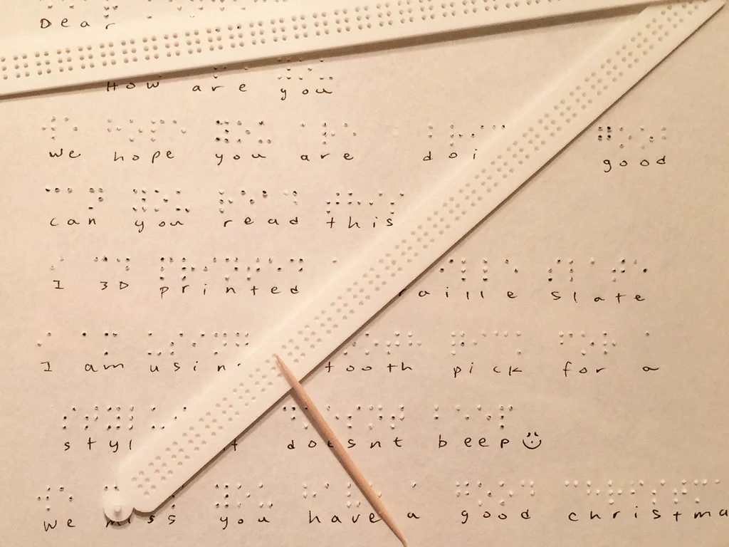
Punching paper
Alternatively, there are numerous Braille models shared on the internet that can be 3D printed. This is just one example but there are many others out there: https://www.tinkercad.com/things/kutEjO9dWaP

Slide 12
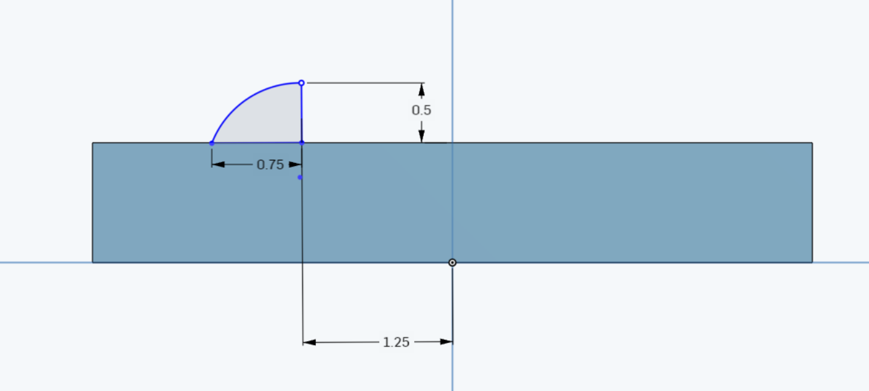
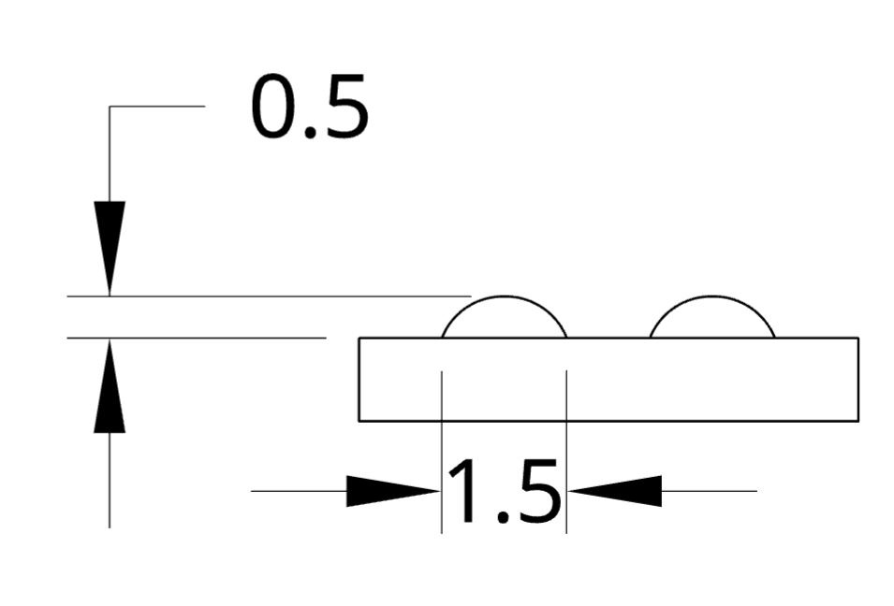
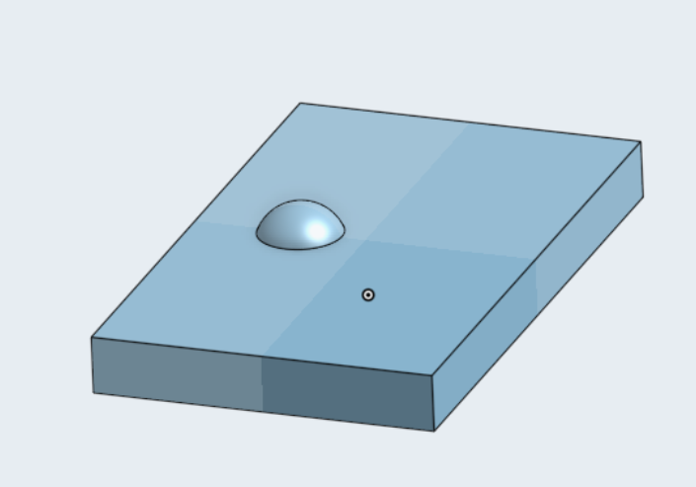
3D print braille tiles
Using a 3D CAD package and the data on the specification for Braille dots, you could create a 3D model to be printed as a tile by drawing half the shape of the dot then revolving it.

Slide 13
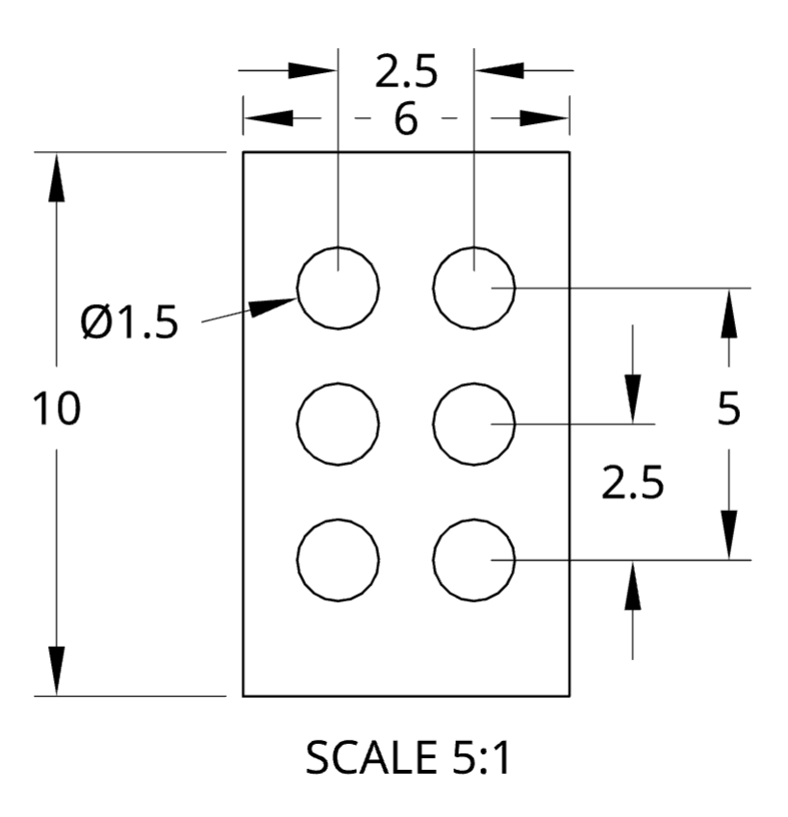
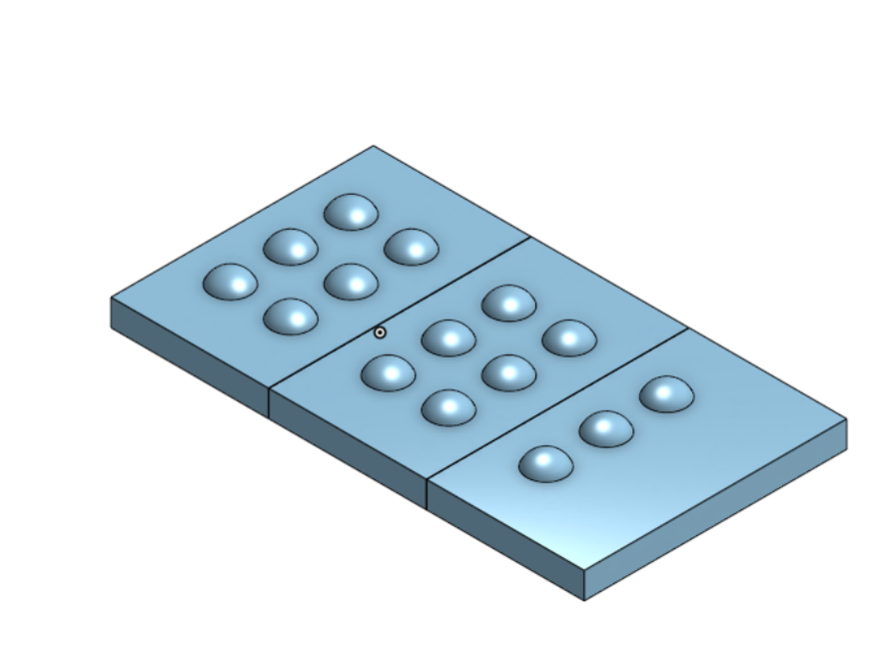
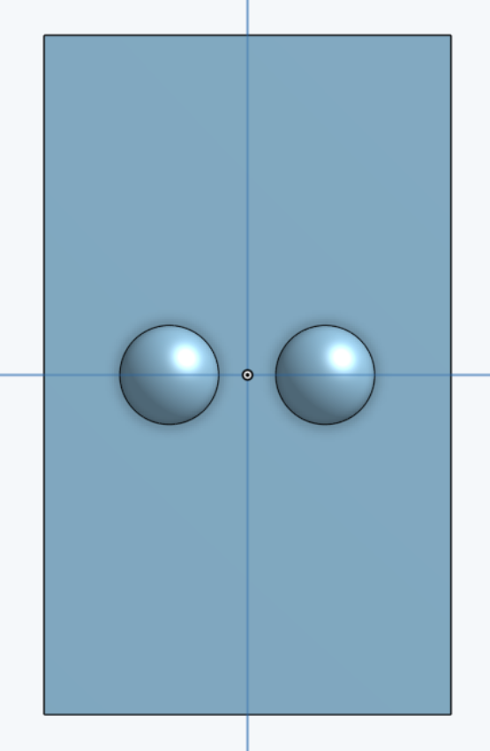
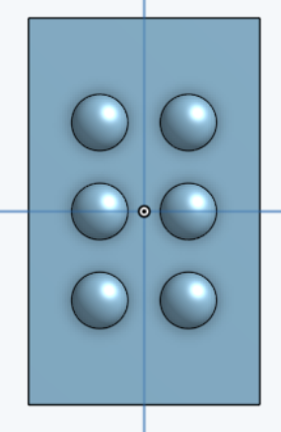
3D print Braille tiles
Using that same data and the array feature of a program such as Onshape, you can copy the first dot to make a Braille tile.
By creating tiles that spell out different letters you can combine them to spell words and print out the necessary tiles and embed them into products as permanent labels that will be more durable.

Slide 14
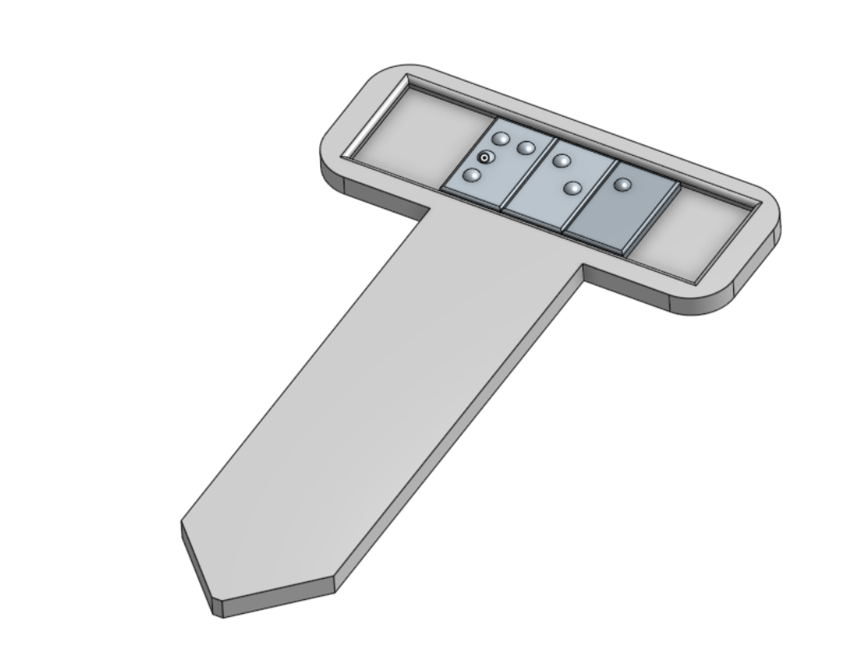
3D print Braille tiles
Try 3D printing some of these tiles and you could design a seed label where the Braille tiles could be placed to spell out the names of plants, herbs, fruits and vegetables. Is there a better way to design this?
Can you tell what the word is on the label?
Notes:
This presents a nice design task to hold the ‘tiles’ and allow them to be swapped out if needed. Also to get the printer resolution to ensure the quality of print is suitable to make it legible.

