Slide 1
Investing in Primary School Membership with The Design & Technology Association
Enhancing Student Progress and Learning and Preparing our Young People for a Technological Future
Presented by: [Enter your name here]

Slide 2
PURPOSE This presentation will demonstrate why our school should invest in membership of the Design & Technology Association.
WE WILL COVER
Importance of design and technology in primary education
Current challenges in design and technology
What does membership offer?
Return on Investment
Success stories from other schools
Alignment with our school goals
Next steps
PAYOFF As a result of this presentation, my objective is to inform and assist the leadership team to feel confident in investing in the Design & Technology Association.

Slide 3
Importance of Design and Technology in Primary Education
Encourages: Analytical thinking, creative thinking, resilience (grit), flexibility and agility, curiosity, technological literacy and empathy.*
Supports multi-disciplinary learning (maths, science, art)
Develops practical skills and real-world understanding
Prepares students for future technological advancements
Informs and excites pupils about possible jobs and careers
* World Economic Forum https://www.weforum.org/agenda/2023/05/future-of-jobs-2023-skills/

Slide 4
Current Challenges in Design and Technology
Lack of specialist D&T teachers in schools across the country*, due to:
Teachers leaving the profession and
Not enough new teachers entering the system
D&T is a subject at the forefront of change and is constantly evolving.
Subject training must allow teachers to keep up with the rapid pace of change (AI, robotics, CAD, coding etc.)
There is a need to focus on re-energizing the KS1 & 2 curriculum to ensure it equips all students with the knowledge, skills, and personal attributes to thrive when they reach secondary school.
D&T teachers cannot and should not work in isolation. The D&T Association
provides a network to support subject development and growth. With
units of work and support structures designed by teachers, for teachers.
*Over 15,000 trained D&T teachers in 2009, just over 6,000 in 2024

Slide 5
What does membership offer?
Projects on a Page: Access to 23 tried and tested curriculum planners, all linked to National Curriculum requirements.
Primary Subject Leadership File: Comprehensive guidance, resources, and support to ensure high-quality D&T provision at {insert school name}.
Primary Self-Review Framework: Support continuous improvement in D&T education with our comprehensive framework that helps schools assess and enhance their D&T delivery.
Termly Glossy Magazines: featuring articles, hints, and tips that exemplify excellent D&T teaching and learning.
Up to date information on D&T trends and innovations.
Discounts on Subject Training and CPD (Average 26%).
Networking Opportunities with other schools and experts.
Access to 100’s of teaching resources at no additional cost.

Slide 6
Return on investment
Annual membership fee £156
Two training course attendances would provide £142 member saving
Typical price for a non-member to attend a course £270
Member price for the same course £199
Member saving £71 per teacher per course
Subject leader time saved through support and resources, of seven hours per year to break even
Assuming the Subject Leader's salary of approx. £23 per hour (156/23)
Improved student engagement and success
Improved teaching quality and curriculum enhancement
Resources that help your school excel against the Ofsted framework.

Slide 7
Success Stories from other schools
"The D&T Association has become an invaluable resource for supporting and advancing design and technology (D&T) across the trust I work for. Whether in primary or secondary education, the skills, knowledge, resources, and guidance they provide are truly exceptional. The team at the Association is incredibly friendly and approachable, always going above and beyond to offer the support you need. Personally, I believe that two standout resources have made a significant impact: Projects on a Page for primary and Inspired by Industry for secondary. These resources offer exactly what’s needed at each educational level, ensuring high-quality teaching that meets and exceeds the national curriculum requirements." - Drew Wicken, Director of Design &Technology and Vocational Education at Co-op Academies.
“It is excellent! Skills are progressive and the way it's been written allows for teacher creativity and pupil voice.”
“I started working with the Year 6 children to introduce the 'Tinkercad' program. They were very enthusiastic, and I was very impressed with how they embraced their new learning... The Design & Technology Associations' resources have certainly made the delivery of the CAD lessons manageable and less frightening” - Marie Myers, St Dominic Catholic Primary School
“It has been wonderful to see the awe and wonder on the pupils' faces and to see them get so excited and be so enthusiastic about their learning.” - Sophie Porteous, Christopher Pickering Primary School.
“We cannot thank the team enough for enabling us to learn more about the use of 3D printers in our Curriculum offer.” - Alison Moxham, Bretherton Endowed Church of England Primary School.

Slide 8
Alignment with our school goals
Enhancing student engagement and achievement in D&T.
Supporting teacher development and confidence.
Promoting a culture of innovation and creativity.
Meeting OFSTED requirements for a broad and balanced curriculum
[Add some of your own school goals.]

Slide 9
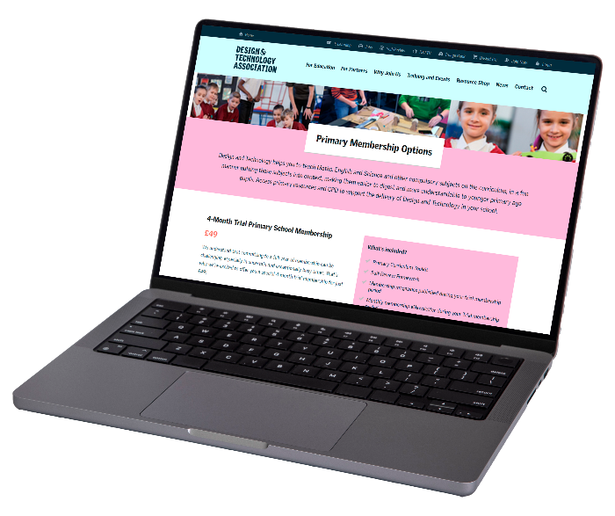
Summary & Next Steps
SUMMARY
Investing in the D&T primary school membership supports {Insert school's name} commitment to high-quality education.
Membership offers valuable resources, training, and community connection.
Let's empower our students to become the innovators and problem-solvers of the future.
NEXT STEPS
Review the membership options and choose the best fit.
Plan for staff CPD sessions to maximize the benefits.
Schedule regular evaluations to measure impact on teaching and learning.

Slide 10
Any questions or concerns?

