Slide 1
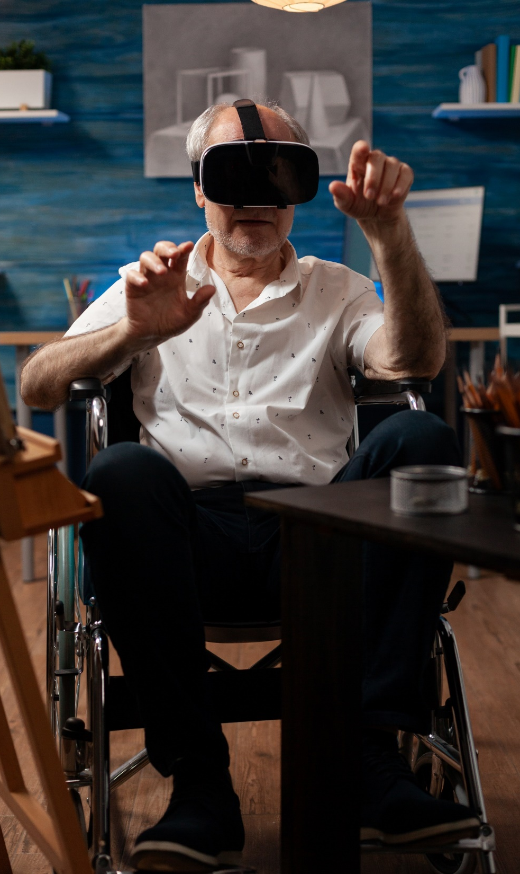
lamb industries Supporting unit investigative & evaluative activity: user experience
#InspiredbyLambIndustries
Notes:
Please note; This resource, accompanying resources and associated images, videos and graphics are to be used for educational purposes only and in line with our terms and conditions as stated here. https://www.designtechnology.org.uk/terms-and-conditions-and-policies/

Slide 2
User experience
Because design and innovation matter
Notes:
Further activities and information is available here: https://www.inclusivedesigntoolkit.com/
With a variety of approaches also mentioned here:
https://www.realityworks.com/blog/12-wearable-diy-simulations-health-science-instructors-can-use-tomorrow/?v=79cba1185463

Slide 3
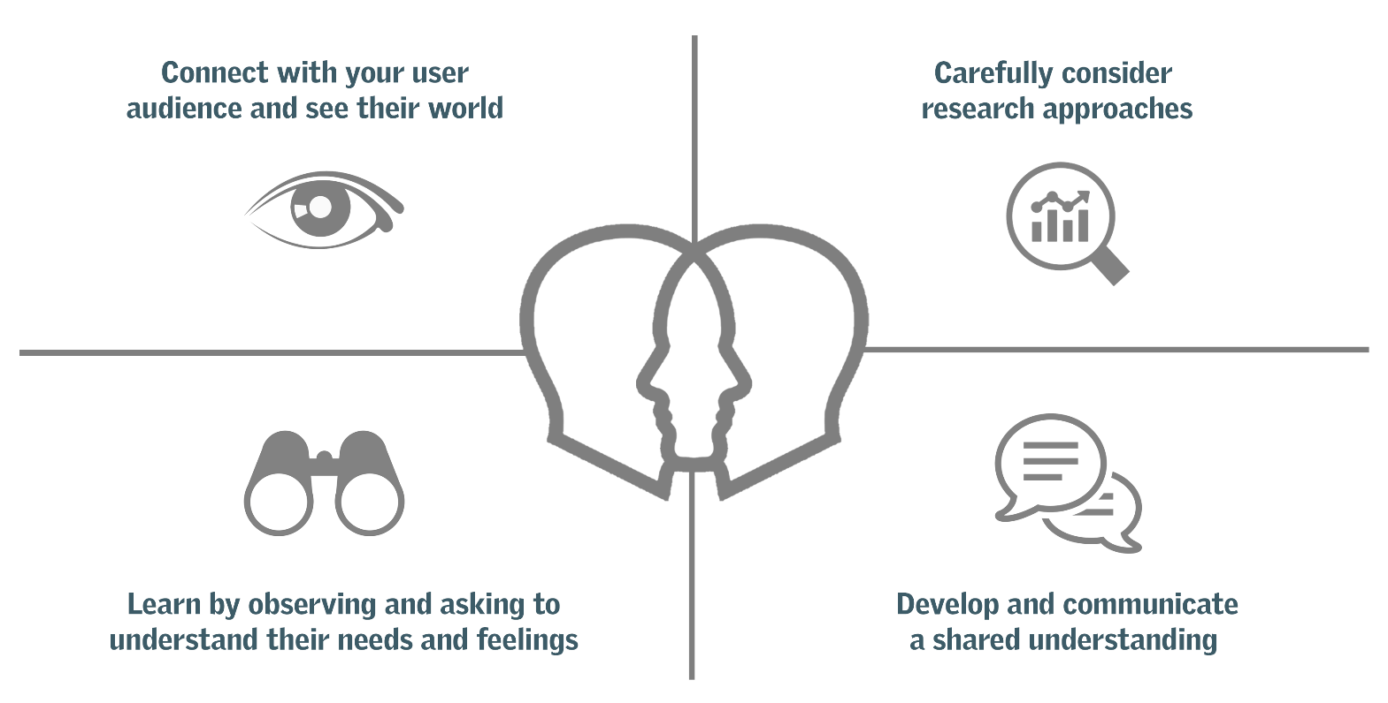
User centred design
To design for others, we need to consider those that will be using our designs. These are the users. User Centred Design (UCD) considers the user in all aspects of the design process as well as their needs, wants and values.
Your initial research should consider a range of user needs as it has to be inclusive/accessible. The user might also represent the product’s intended ‘target market’.

Slide 4
Empathetic design
Trying to understand the problems various users may have can be difficult if you have not experienced it for yourself.
Understanding the needs and feelings of others is known as empathy and when we apply this to designing products, it’s sometimes referred to as ‘empathetic design’.
Throughout this unit we will be considering the needs of others rather than focusing on the commercial, technological or visual appeal of mainstream consumer products which is something we often do when researching market needs.

Slide 5
DIY simulations
DIY simulations go a tiny way to emulate the challenges that many people face with regards to visual impairment, loss of tactile sensation, hearing impairment and more. You need to remember that using these ‘simulations’ is a rather crude, and obviously temporary insight into what it is like for people that live with these conditions and alongside it, there may be related conditions, for example, if you experience visual impairment, you may also be tactile-hesitant (meaning you don’t like touching/feeling different textures).
However, it may help you to empathize with some conditions and have a small insight into a world that is not like how you experience it.

Slide 6
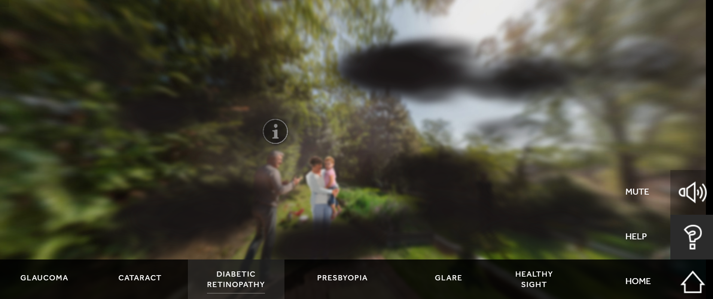
Vision
Visual impairment can be replicated to some extent by the following methods:
Wearing a blind-fold is an obvious demonstration into sight-loss, and there are also some online simulators that go some way to recreating visual impairment
Use an abrasive or Vaseline on the lens of some old eye protectors
Wear strong prescription glasses not intended for the user
Tinted lenses can replicate aspects of colour blindness
Cutting a small hole in a piece of card and placing over glasses or goggles to recreate tunnel vision
Notes:
Try https://versanthealth.com/vision-simulator/#launchVIS or https://sightcentertoledo.org/eyeconditions/vision-impairment-simulator/ for an online simulator

Slide 7
hearing
We can simulate an impairment of hearing by
Playing white noise at a volume that drowns out external noise
Wearing noise cancelling headphones
Using ear protectors or earplugs
Wearing in-ear headphones that block out external noise
Tinnitus could be simulated by playing a sustained, high pitch noise
Please do take extra care if simulating a hearing impairment and remember that certain noises can also be very distracting for those with regular hearing.
Notes:
https://rnid.org.uk/information-and-support/tinnitus/what-tinnitus-sounds-like/
https://www.bootshearingcare.com/hearing/hearing-loss-simulator/simulator/

Slide 8
mobility
Mobility issues can vary from user to used but can be replicated in a variety of ways. Try some of these:
Tie one arm to your body so it can’t be used and try to carry out everyday tasks
Tie your legs to a seat then try to reach for objects that you need without leaving the chair
If you can access a wheelchair, try moving around an area and try to reach storage cupboards or try sweeping the floor or using a vacuum cleaner
Try the same while on crutches, possibly tie up one leg so it can’t be used instinctively.
As with all simulations of impairments, take extra care in the environment and remove any risks or hazards but do think about users with mobility issues who don’t have that luxury.

Slide 9
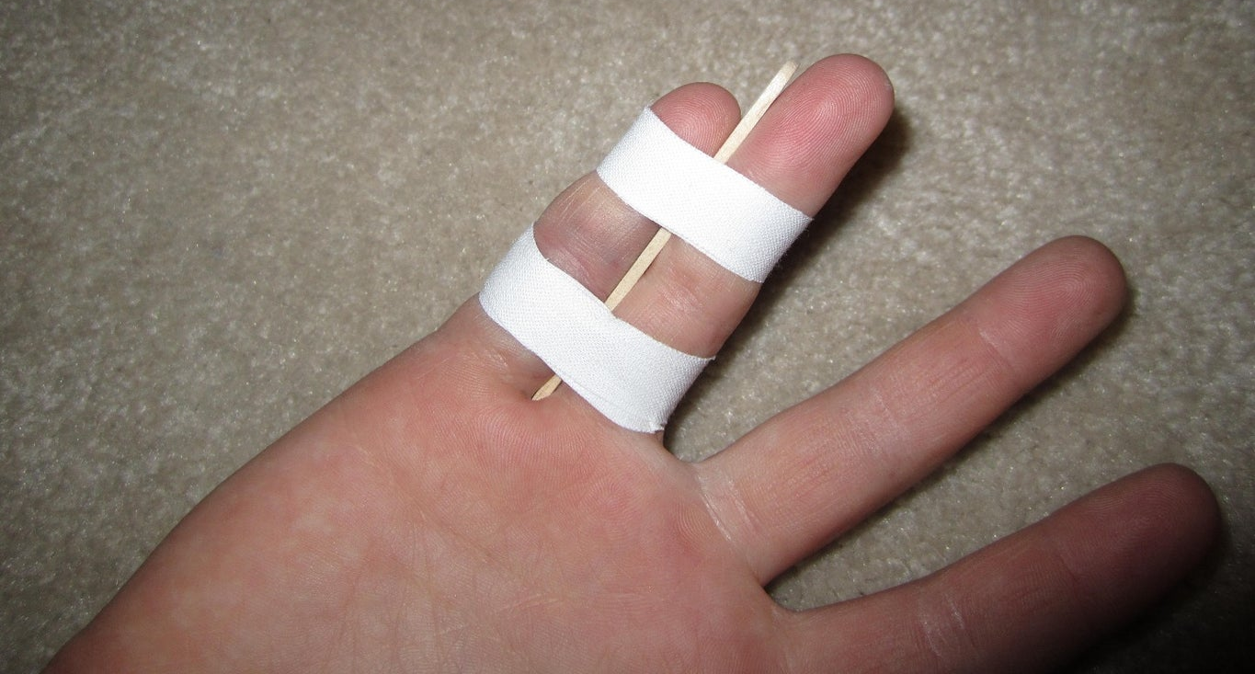
understanding/dexterity
Even without a hearing, vision or mobility impairment, users can have trouble with perception and understanding, or they may have problems performing tasks that others find easier to do.
These may include, but not be limited to:
Labels and instructions that are difficult to understand
Difficulty with fine motor skills such as threading a needle or opening a jar or can
Difficulty opening and closing packaging containers.
Taping lollipop sticks to fingers makes them much harder to bend and simulates extreme arthritis

Slide 10
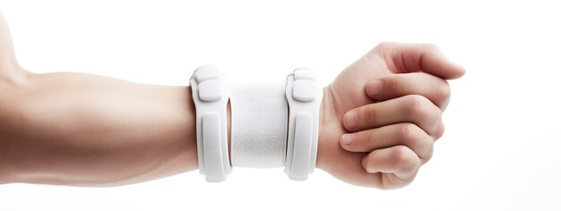
strength
As young people, we may take for granted the strength we have to perform everyday tasks, but what if you were weaker or had less strength than necessary?
Consider some of these:
Difficulty opening the lid on a jar
Difficulty gripping objects in the kitchen
Difficulty lifting or carrying shopping bags
Difficulty opening doors or windows
Difficulty operating machinery or vehicles
How could you address these and make life easier for the user?

Slide 11
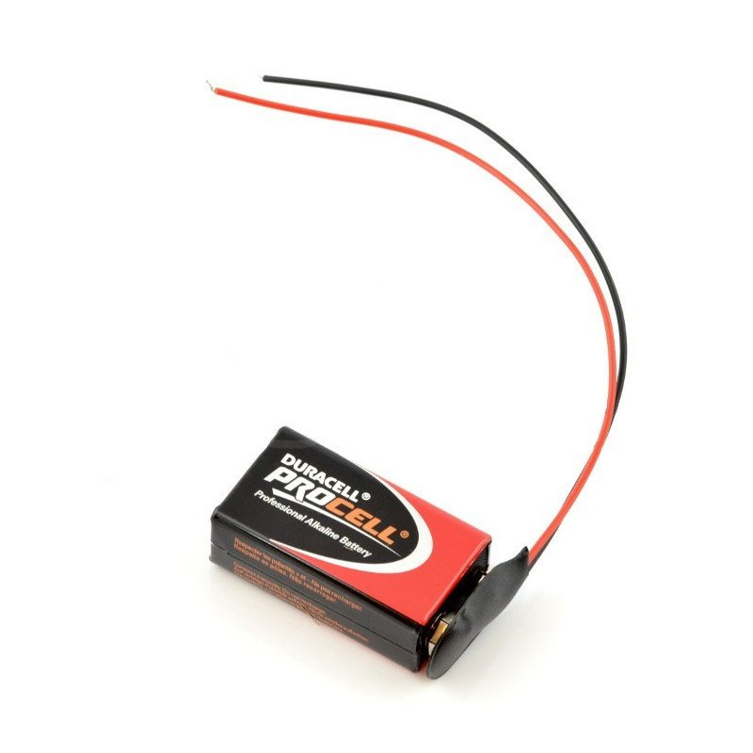
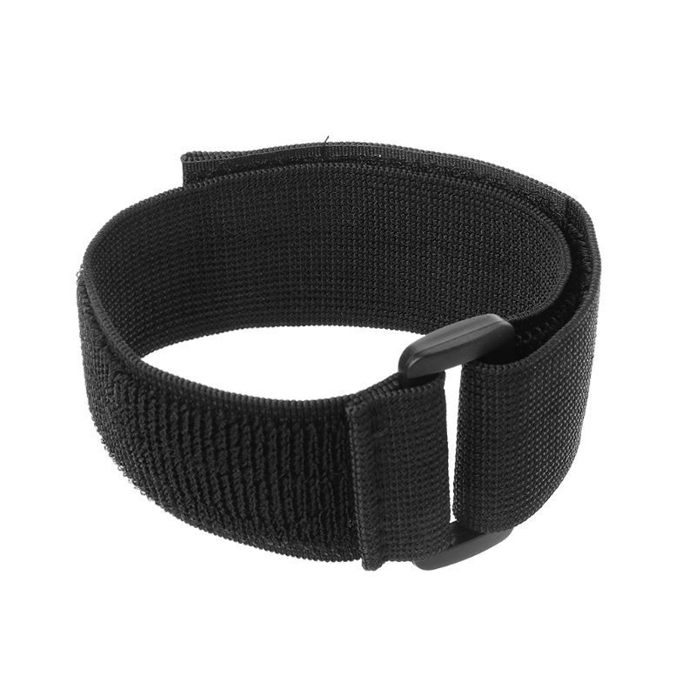
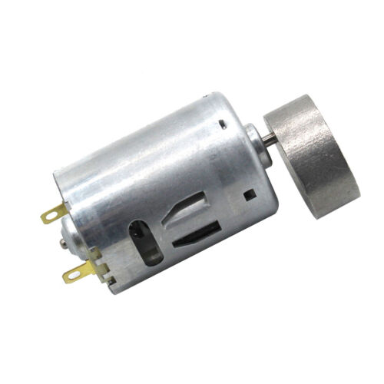
Medical conditions
Some medical conditions will have specific symptoms that cause difficulties for those affected. One example is Parkinson’s Disease which can cause uncontrollable shaking. Imagine trying to eat your breakfast cereal with someone shaking the hand holding the spoon.
This can be recreated by using a ‘vibration’ motor strapped to the users’ wrist. Attached to the motor is an offset cam (drilled off centre). As this rotates it causes vibrations and, when worn, simulates the symptoms of Parkinson’s.

Slide 12
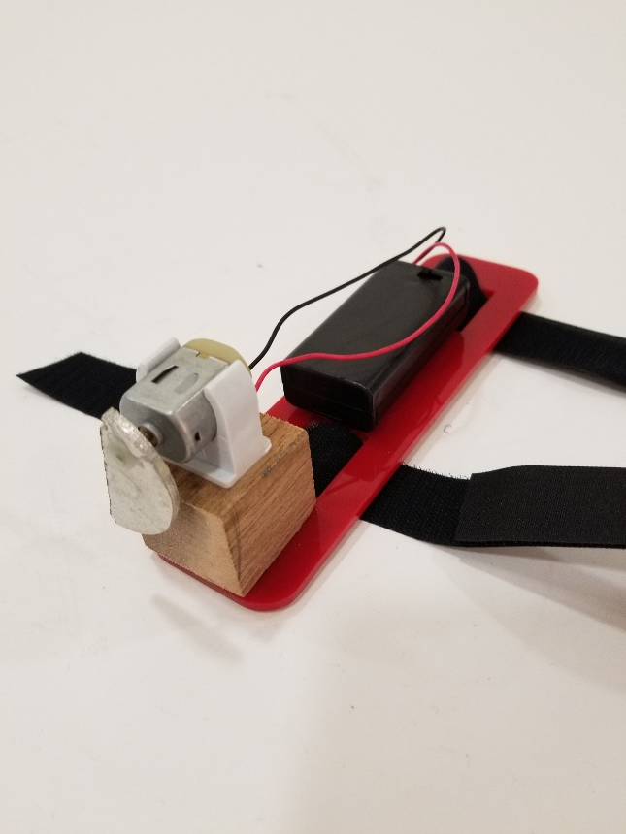
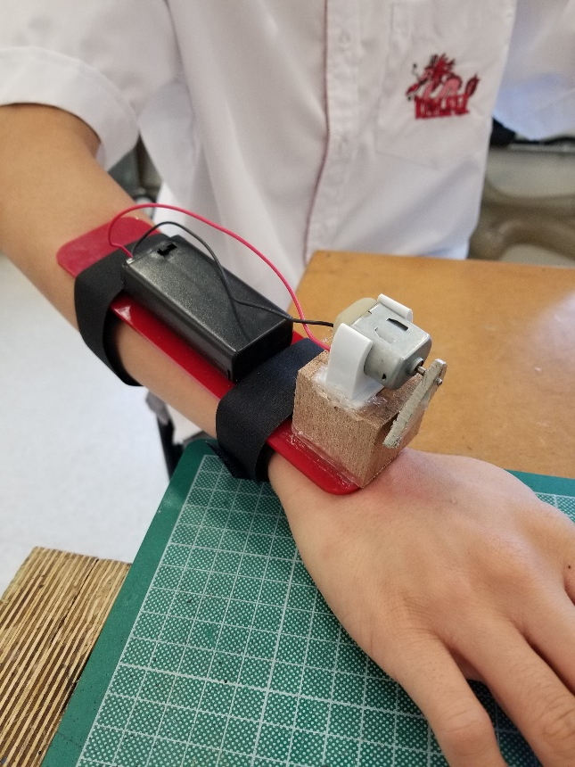
Shake simulator
This is an example of a completed shake simulator created by Simon Wood at Kellet School, Hong Kong.

Slide 13
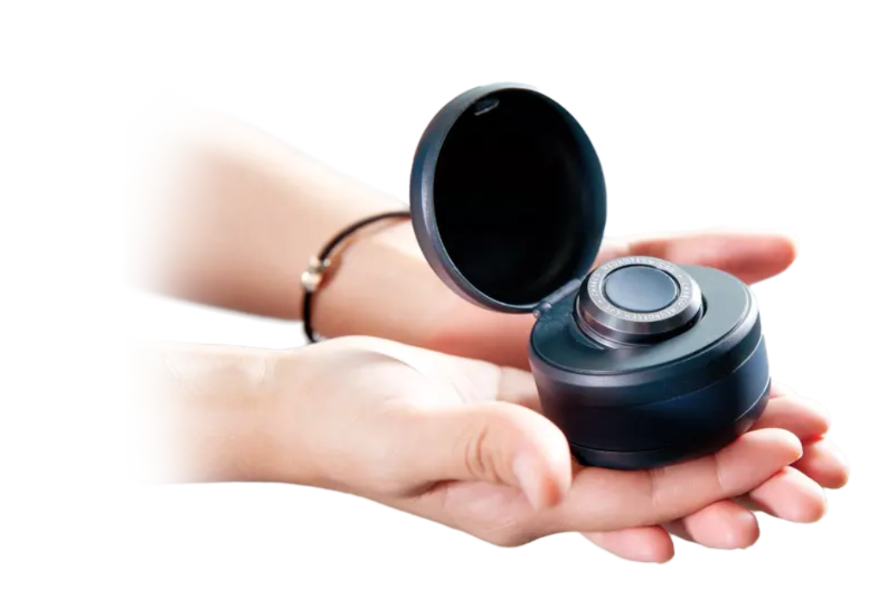
Medical conditions
That same problem and the creation of a device to replicate the shaking could have been the inspiration for devices on the market that can counteract the shaking to provide greater stability for patients therefore increasing their quality of life: https://charconeurotech.com/
Notes:
A clip from The Big Life Fix that may be of interest:
https://www.youtube.com/watch?v=DZ6E49B_Pec

Slide 14
Empathetic design
Using the printable cards on the next slide, randomly select a product card and an impairment card. Now using an empathy approach, simulate the loss of a limb and try to use the product as normal.
In this example, how would the loss of a limb cause problems using a watering can full of water?
This might be difficulty carrying if it the loss of a leg, arm or hand, but even missing a finger could make this much more difficult than expected.
Try this with an empty watering can at first to avoid accidents, but note down any problems you encountered so you can address this in your own design work.

Slide 15
Empathy Activities
Notes:
Print and cut these cards for an empathy-design activity. Students can choose a tool and impairment at random to help generate new ideas for a range of users. This can be particularly useful if they are stuck for ideas / focus. Feel free to add more of your own.

Slide 16
Empathetic design
Make a chart of your experiments and observations. Are there any problems or issues common to a range of impairments that you could address to make your products more inclusive?
Type of impairment | Process | Hazards | Observations | Feedback
Visual | Navigating the classroom | Tripping, bumping into others, falling over | There are no tactile or auditory cues to help navigation
Mobility | Using power tools in a wheelchair | Cutting or drilling into your leg or arm.
Strength | Carrying a toolbox | Cannot lift off floor. Cannot carry it from bench to cupboard
Understanding | Using IKEA instructions for non-English readers
Hearing | Awareness of fire alarms | Cannot hear a fire alarm, could die in a fire! | Watching others moving out can give a clue but also be confusing and scary. What is going on? | There could be a personal device that vibrates or a lit-up/flashing sign in the room that they can see. In a noisy workshop this would help everyone ☺

